Slide 1
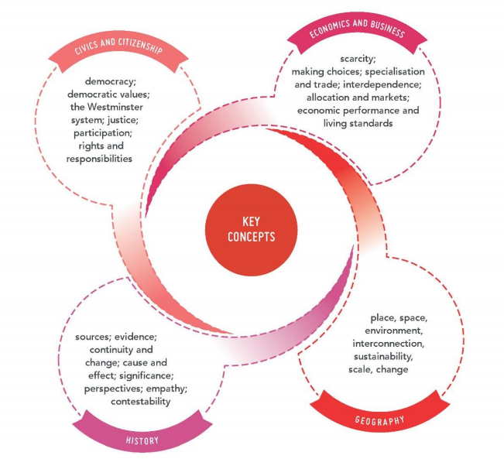

Slide 2


Democracy
A system of government in which people choose their rulers by voting in elections.
http://www.abc.net.au/btn/story/s4460249.htm
https://www.youtube.com/watch?v=qbN9kx6YHQQ

Slide 3


Democratic values
The Australian democracy has at its heart, the following core values:
Freedom of election and being elected
Freedom of assembly and political participation
Freedom of speech, expression and religious belief
Rule of law
Human rights

Slide 4
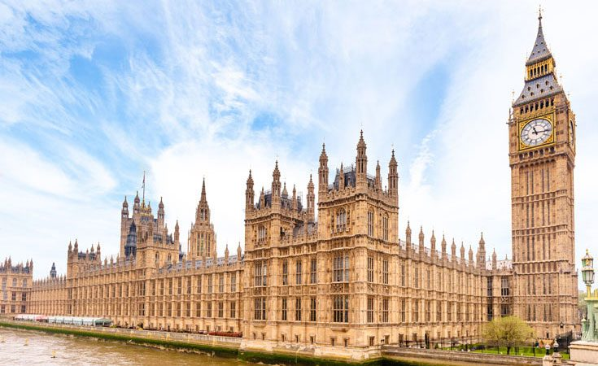
The Westminster System
A democratic system of government modelled from the United Kingdom (Palace of Westminster of British Parliament).
Features of the Westminster system:
Executive branch – made up of members of the legislature and Prime Minister
Opposition parties
Bicameral or Unicameral legislature
Ceremonial head of state (Queen Elizabeth II)

Slide 5

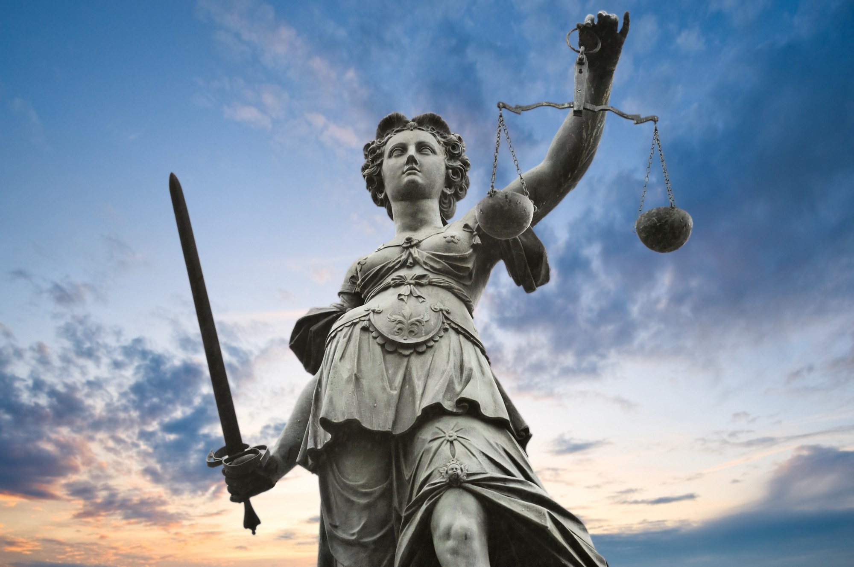
Justice
Fairness in the way people are treated.
Equality before the law
No one is above the law

Slide 6

Participation
How an individual can be involved in the political and legal system.
As both a decision maker
As an agent of change
For example, people can participate in the Australian government by voting. http://www.abc.net.au/btn/story/s4464749.htm

Slide 7
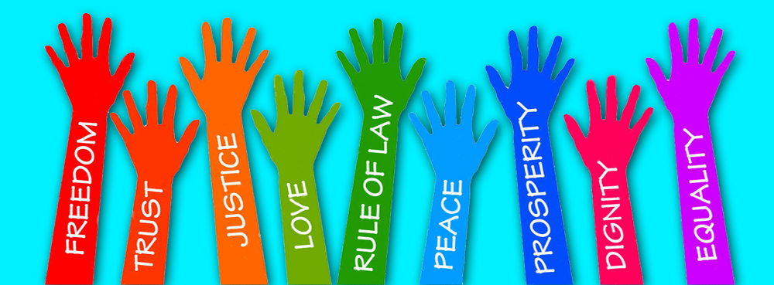
Rights and responsibilities
A right is a freedom that is protected (human rights).
A responsibility is a duty of something you should do (voting).
For example, human rights are basic entitlements that belong to every one of us.
https://www.youtube.com/watch?v=oh3BbLk5UIQ (10)

Slide 8
Success Criteria
On the scrap piece of paper given to you, write your name and complete these activities.
1. In one sentence, briefly explain what the study of civics and citizenship is
2. List the 6 key concepts of civics and citizenship

